Slide 1
Draft National Strategy for the Care and Support Economy
OFFICIAL
ESORT briefing 11 July 2023
Care and Support Economy Taskforce

Slide 2
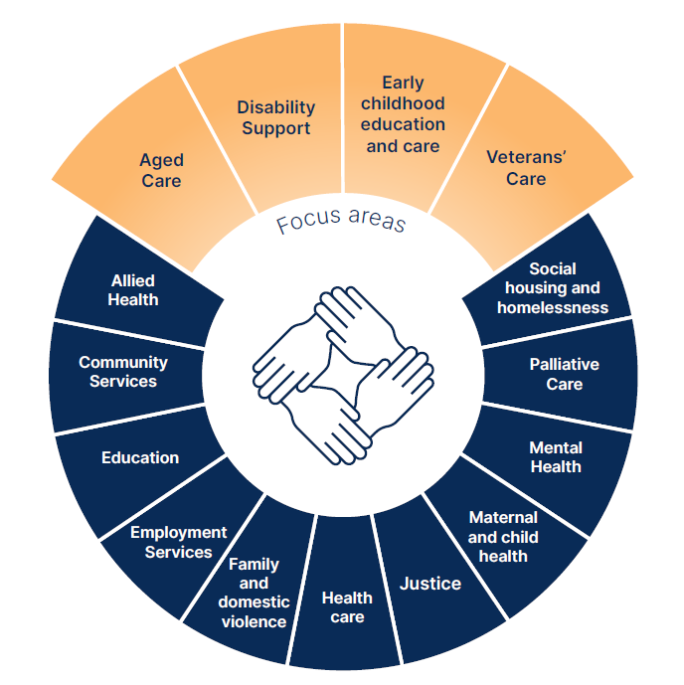
Care and Support
Care and support are activities that develop and maintain people’s capabilities, independence or quality of life.
It is a broad eco-system of health, education and social care across a person’s lifetime.
The care and support economy - the provision of paid care and support - is one of Australia’s fastest expanding economic sectors.
Source: draft National Care and Support Economy Strategy, p5
OFFICIAL

Slide 3
Care and support sectors are a significant part of the Australian economy and society that look after some of our most vulnerable
OFFICIAL
Aged Care
Veterans Care
Disability
Early Childhood Education & Care
1.3 million aged care consumers
42,000 clients of veterans’ care programs
573,000 NDIS participants
1.4 million children attending approved child care services
The care and support economy:
This project is focused on aged care, disability support, veterans care and early childhood education and care (ECEC)
Government is the major funder of care and support, with significant growth in expenditure forecast ($ billion)*
The workforce is large and growing:
Employs over 600,000 people as at 2021-22
146,700 in Centre-based Day Care
460,000 in aged care, disability support and veterans care
Workforce expected to increase to about 1 million by 2049-50
One of Australia’s largest and fastest growing workforces –aged and disabled care workers grew 72% between 2016 and 2021
*PM&C analysis of Budget 2023-24. Shading shows forecast Government spending
This is a significant portion of the Budget
Increasing from 10.6 per cent of Australian Government payments in 2021-22 to 14.7 per cent in 2026-27
Sources: Care Workforce Labour Market Study. ECEC Workforce Census 2021.
PM&C | Care and Support Economy Taskforce | ESORT Briefing – 11 July 2023

Slide 4
What we heard – Research and stakeholder consultation
There is increasing demand for care and support – driven by social and demographic trends.
There are increasing demands for quality and consumer-driven care – all 148 recommendations from the Aged Care Royal Commission aim to drive improved quality.
A large workforce supply gap is emerging and is being felt by providers
Attempts to resolve workforce pressures in one sector risks shifting workforce problems to others.
Separate regulatory arrangements across the sectors stifles fluidity for providers and workers and creates inefficiencies – high proportions of providers operate in more than one sector.
Service sectors are thought to have limited capacity to drive productivity through innovation.
Thin markets mean some are not getting the services they need
Funding models significantly influence the operation of the system and incentivise provider behaviour
These are not seen as good jobs: poorly paid, unsafe, insecure
OFFICIAL
PM&C | Care and Support Economy Taskforce | ESORT Briefing – 11 July 2023
Notes:
Sources
211,400 FTE workers required – National Skills Commission 2022 Care workforce labour market study
Differing pricing structures; 80 IT systems: Department of Health and Aged Care regulatory harmonisation / thin markets analysis

Slide 5
The draft National Strategy
OFFICIAL
Takes a holistic view with a focus on improving quality, accessibility and sustainability
OFFICIAL

Slide 6
What we’ve done
OFFICIAL
Submissions now closed
About 370 submissions
Strong engagement on our social media promoting the consultation
State and Territory engagements
Departmental briefings
Over 600 stakeholders briefed
OFFICIAL

Slide 7
Vision
A sustainable and productive care and support economy that delivers quality care and support with decent jobs
Goals
Quality care and support
Decent jobs
Productive and sustainable
Person-centred services that recognise those accessing care and support as individuals and deliver quality outcomes
Secure, safe jobs with decent wages, conditions and opportunities for career development
A care and support economy that has functioning markets, sustainable funding and generates productivity gains
Objectives
1.1 People have access to the care and support they need
1.2 Workforce has the right skills and training to deliver quality care and support
1.3 Workforce supply meets demand
1.4 Services are culturally and psychologically safe for all people
1.5 People are able to easily navigate systems, assess service quality and access care and support
1.6 The contribution of informal carers is valued, and they are supported to sustain their caring roles
2.1 Pay and conditions reflect the value of care and support work
2.2 Work is organised and jobs are designed in a way that promotes good job quality and worker satisfaction
2.3 Jobs are professionalised and there are pathways for skilling and career progression
2.4 Workplaces are safe and healthy, and psychological and physical risks are eliminated or, if this is not possible, minimised 2.5 Improved leadership and management capability across the care and support economy
2.5 Improved leadership and management capability across the care and support economy
2.6 Workplaces are inclusive of diverse cultures, genders, ages and abilities and are culturally safe for all workers, including First Nations workers
3.1 Government investment and expenditure in the care and support economy is effective and sustainable, with fair and reasonable consumer contributions where appropriate
3.2 Regulation is simplified and made more efficient to comply with, without compromising quality and safeguards
3.3 Funding models support market sustainability, job quality for workers and quality care and support, including consumer choice and control
3.4 Innovation is shared, adopted and adapted across the care and support sectors
3.5 Opportunities in data and digital are harnessed to enable quality care and support, decent jobs and productivity growth

Slide 8
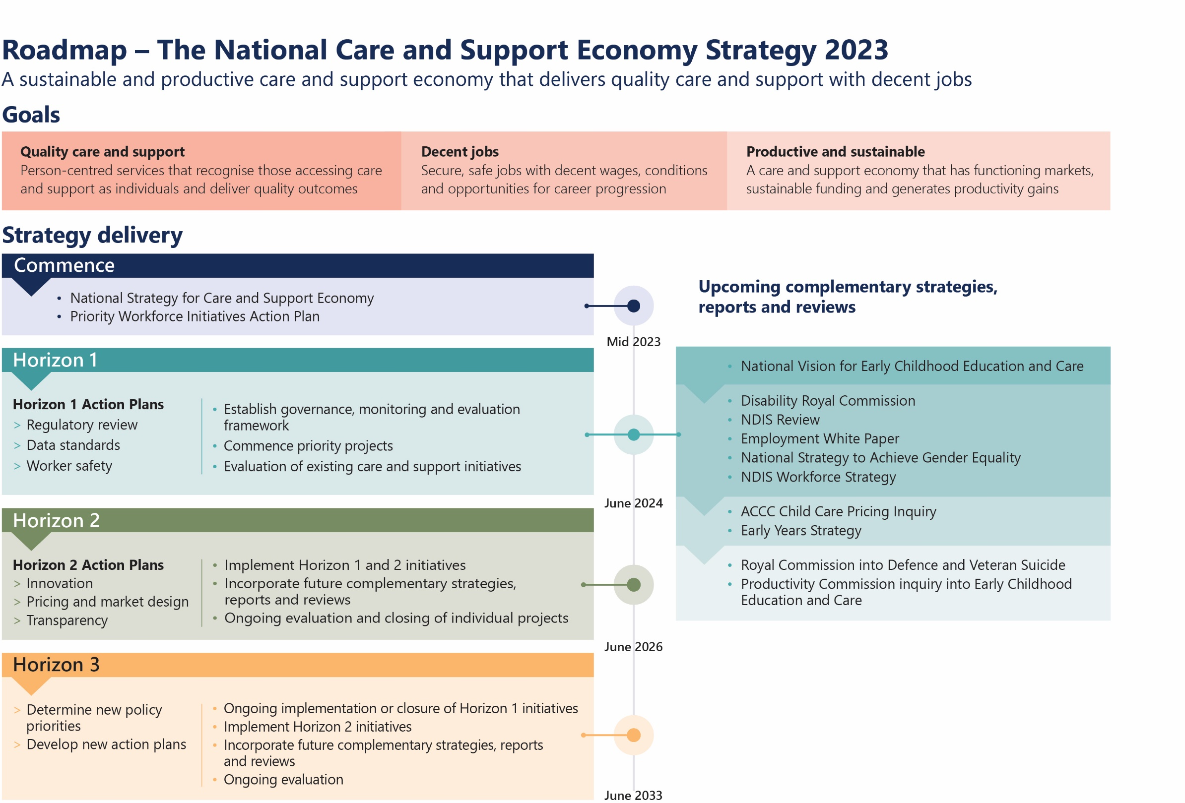
OFFICIAL
OFFICIAL

Slide 9
National Cabinet – agreed priority projects
OFFICIAL
Streamline worker screening
Led by Department of Finance
Improve worker safety
Develop collaboratively with states and territories
Grow the First Nations workforce
Taskforce working with NIAA, states and territories
OFFICIAL

Slide 10
Intersections with Veterans’ care and support
OFFICIAL
Pricing disparities can lead to lack of service provision
Concerns about mainstream NDIS and aged care services for veterans
Lack of services in regional areas
Urgent need for reforms

Slide 11
Close
OFFICIAL
OFFICIAL

